Slide 1


Slide 2
A STUDY ON UNDERLYING STRUCTURE OF A GOLD PRICE DATASET AND BULIDING FORECASTING MODEL FOR PRICE PREDICTION
By
GROUP -04
Under the guidance of

Slide 3





Project Architecture
Data Understanding
EDA Visualization
Model Building
Model Deployment
Model Evaluation

Slide 4
Objective
Studying various season pattern changes observed during the economic down or upturns.
Alongside, analysing various factors that cause the change in the gold price
Studying and interpreting the negative/ positive correlation of such variables causing gold price movement
Come up with a suitable forecasting model which can effectively forecast gold prices for next 30 days.

Slide 5
EXPLORATORY DATA ANALYSIS
1.Describing Dataset
2.Clean data and handling missing values and outliers
3.Visualise data distributions through bar charts, histograms, box plots
4.Observe Correlations between variables and visualise Heat Map etc
5. Splitting data
First 70% of the data is used for training and remaining data for testing
data_train is training dataset
data_test is test dataset

Slide 6
Data Set Details
2182 observations and 2 features
In dataset there is no NAN values

Slide 7
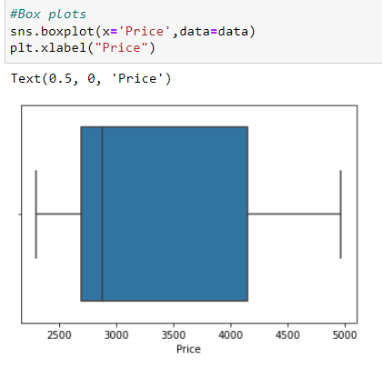
Exploratory Data Analysis(EDA)
Date is objective type data converted into date time format
Changed index in order to make it proper time serious data
No outliers present in the dataset

Slide 8
Data set details
Shape of the Dataset = 2182, 2
Data ranges- Price=
Missing values = no missing or null values

Slide 9
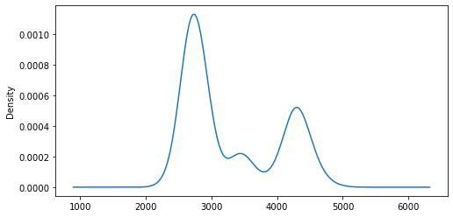
Exploratory Data Analysis(EDA)
Histogram : Data is NOT normally distributed and it is Positively Skewed.

Slide 10
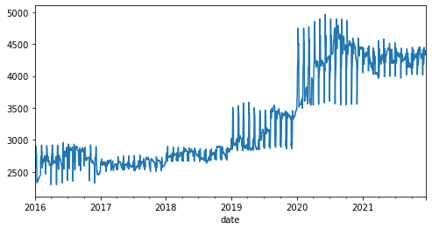
Exploratory Data Analysis(EDA)
Insight: Trend is upward or positive

Slide 11
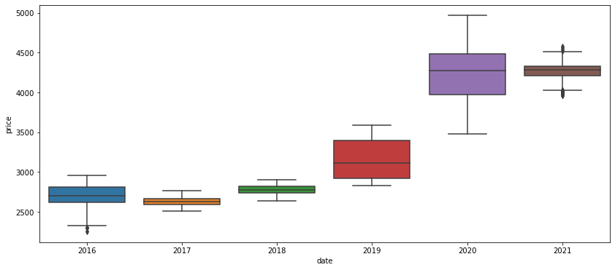
Exploratory Data Analysis(EDA)
Seasonality of the Time Series year wise
Insight: The growth in the price has much more of an exponential growth

Slide 12
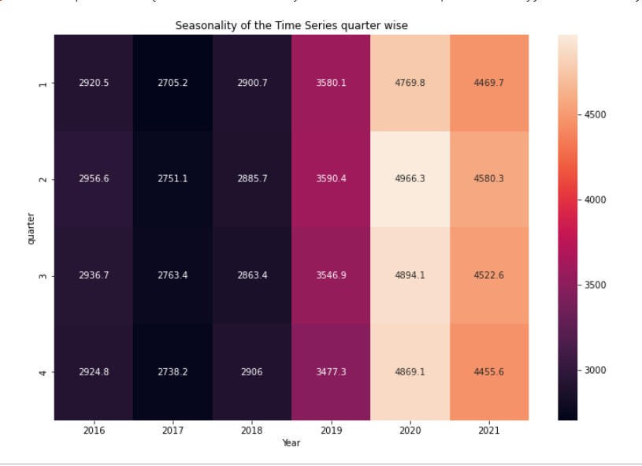
Heat map for monthly average prices
Insight : Maximum price was at quarter 2 in the year 2020.
Every 2nd and 3rd quarter has maximum price in their respective.

Slide 13
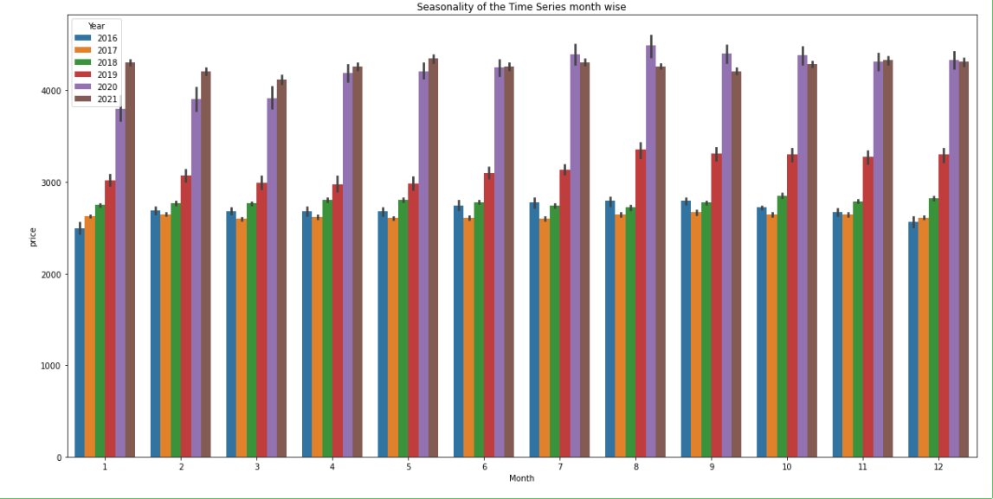
Seasonality of the Time Series month wise
In August 2020, the price went high and in January 2016, the price is all time low

Slide 14
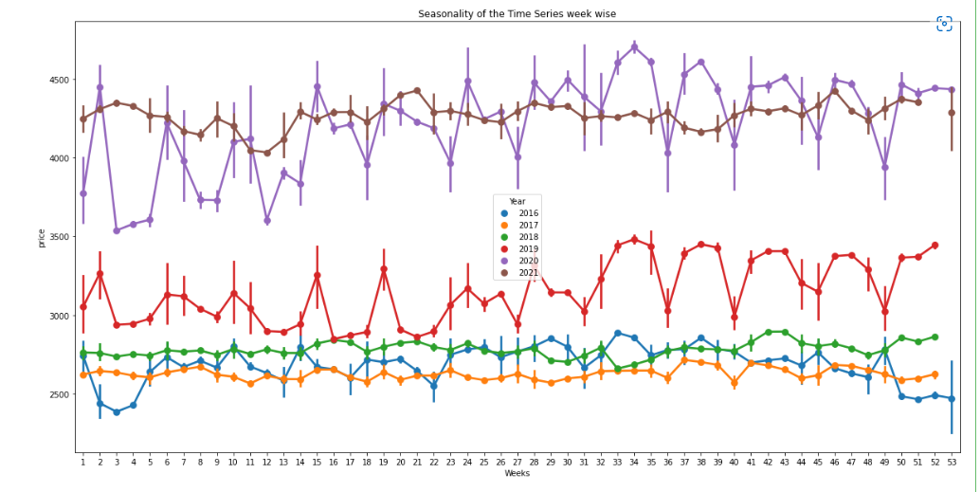
Seasonality of the Time Series week wise
Week wise fluctuation is very high compared to month and quarterly wise
In week of 34th of every year the price was high
We can see in the year 2016, 2017, 2018 and 2019 the price were in between 2500 to 3500 but in last two years, the price went high more than 10K just in one year so there may be an influence of an external factor like (covid)

Slide 15
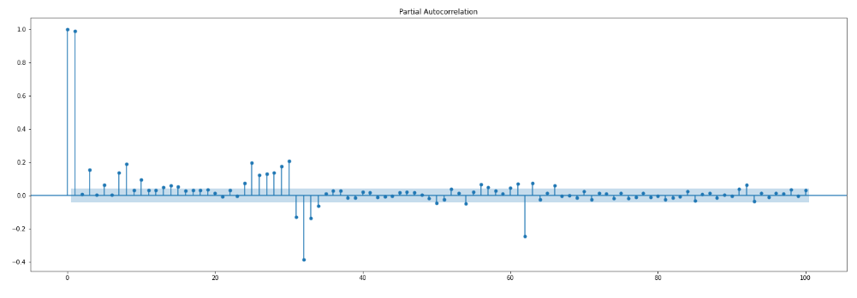
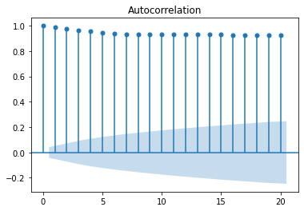
Insight : Autocorrelation plot suggest that immediate lags have significate relationship to build a good forecasting model

Slide 16
Checking the Seasonality
AD Fuller test

Slide 17
p value:0.0 , Series is Stationary
Differencing

Slide 18
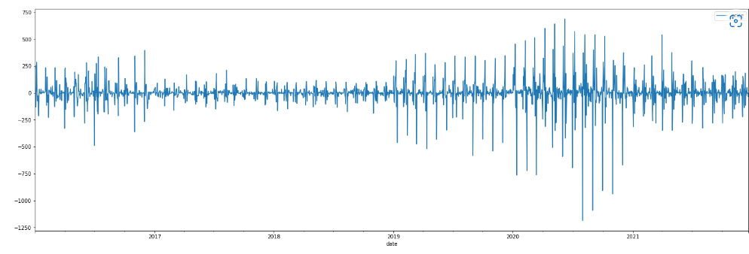
After Differencing stationarity
Differencing to make data into stationarity
Here the mean of the data became constant and hence our data is stationary.

Slide 19
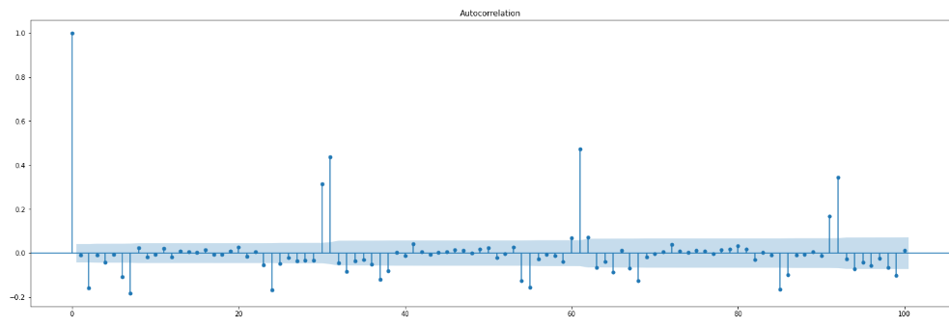
ACF Plot after Differencing
From here we can decide q value is 0 , 2 and 6 or 7

Slide 20
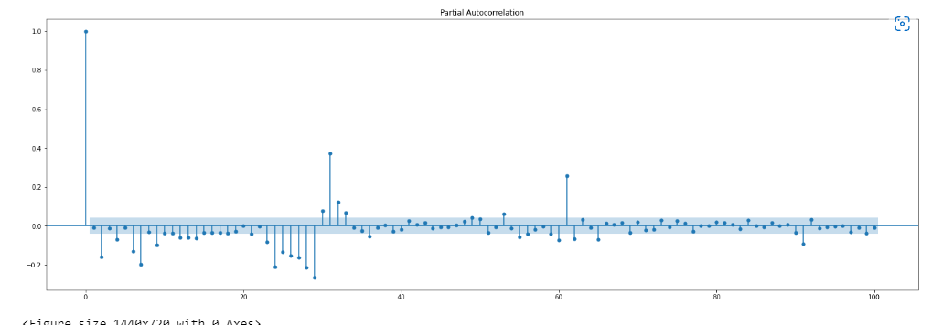
PACF Plot after Differencing p=0,2,4,6,7..

Slide 21
Model Building
In this project, We investigate the usage of different models to predict the gold price
Time Series Models

Slide 22
EXCEL SHEET SS

